Slide 1

Heuristic Search In Machine Learning
SUBMITTED BY: P. Sai Ganesh Reddy(192525111)
Supervisor Dr. Nattar Kannan

Slide 2
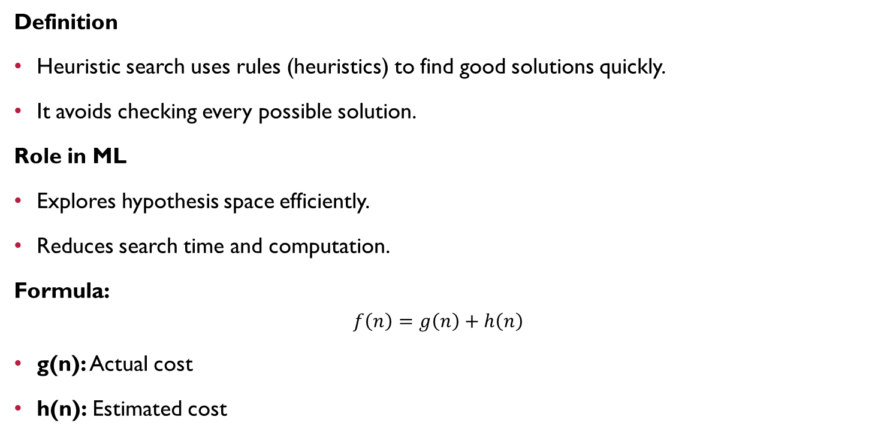
Heuristic Search
Definition
Heuristic search uses rules (heuristics) to find good solutions quickly.
It avoids checking every possible solution.
Role in ML
Explores hypothesis space efficiently.
Reduces search time and computation.
Formula:
$$f\left(n\right)=g\left(n\right)+h\left(n\right)$$
g(n): Actual cost
h(n): Estimated cost

Slide 3
Hypothesis Space Exploration
Hypothesis Space
Set of all possible models.
Heuristic Search
Chooses promising models first.
Eliminates poor choices.
Speeds up learning.
Common Heuristics
Information Gain
Gini Index
Error Rate

Slide 4
Search Process
Steps
Generate solutions.
Evaluate using heuristic.
Select the best.
Repeat until a good solution is found.
Algorithms
A* Search
Greedy Search
Hill Climbing
Beam Search

Slide 5
Applications
Decision Trees → Information Gain
A* → Shortest path
Feature Selection → Best features
Neural Architecture Search → Optimized networks
Benefits
Faster learning
Less computation
Better accuracy

Slide 6
Conclusion
Summary
Heuristic search guides machine learning efficiently.
Finds optimal or near-optimal solutions.
Saves time and computational resources.
Key Advantages
Fast search
Reduced complexity
Improved performance
Scalable for large datasets

Slide 7

GEOTAG PHOTO:

Slide 8

Thank You

